Slide 1

Application “Easy Learn”
Developed by Group1
Mengru.JI
JunQI.Sun

Slide 2
Content
Introduction (Mengru.Ji)
Detail of Application (Mengru.Ji)
Login and SignUp Activity (Junqi.Sun)
Main Activity (Junqi.Sun)
Daily Attendance (Mengru.Ji)
Mission Activity (Mengru.Ji)
Mission Result Activity (Mengru.Ji)
Wrong Mode Activity (Mengru.Ji)
Question Book Activity (Mengru.Ji)
Timer Activity (Junqi.Sun)
Achievement Activity (Junqi.Sun)
Summary (Junqi.Sun)

Slide 3
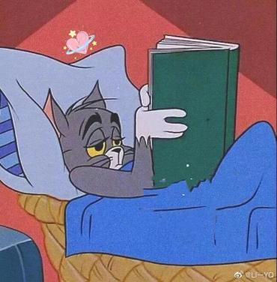
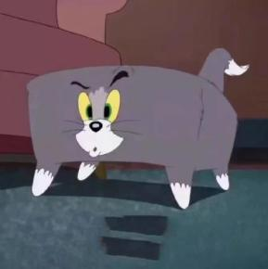

1 Introduction
1.1Motivation
Want to have a Customized Learning Application that More Suitable for Our Own Needs
Lack of Passion for Learning German
Use it to repeatedly practice German exercises that collected by ourselves

Slide 4




1 INTRODUCTION
1.2 Overview (Main Part of this Application)
Consolidate Grammar and Vocabularies in the Form of Single-choice Questions
Simple Pomodoro
(At this stage just implemented by a Countdown)
Have your Own Account
(Personal Wrong Question Book, Learning Record etc.)
Have Fun with your Friends
(Answer contest)

Slide 5
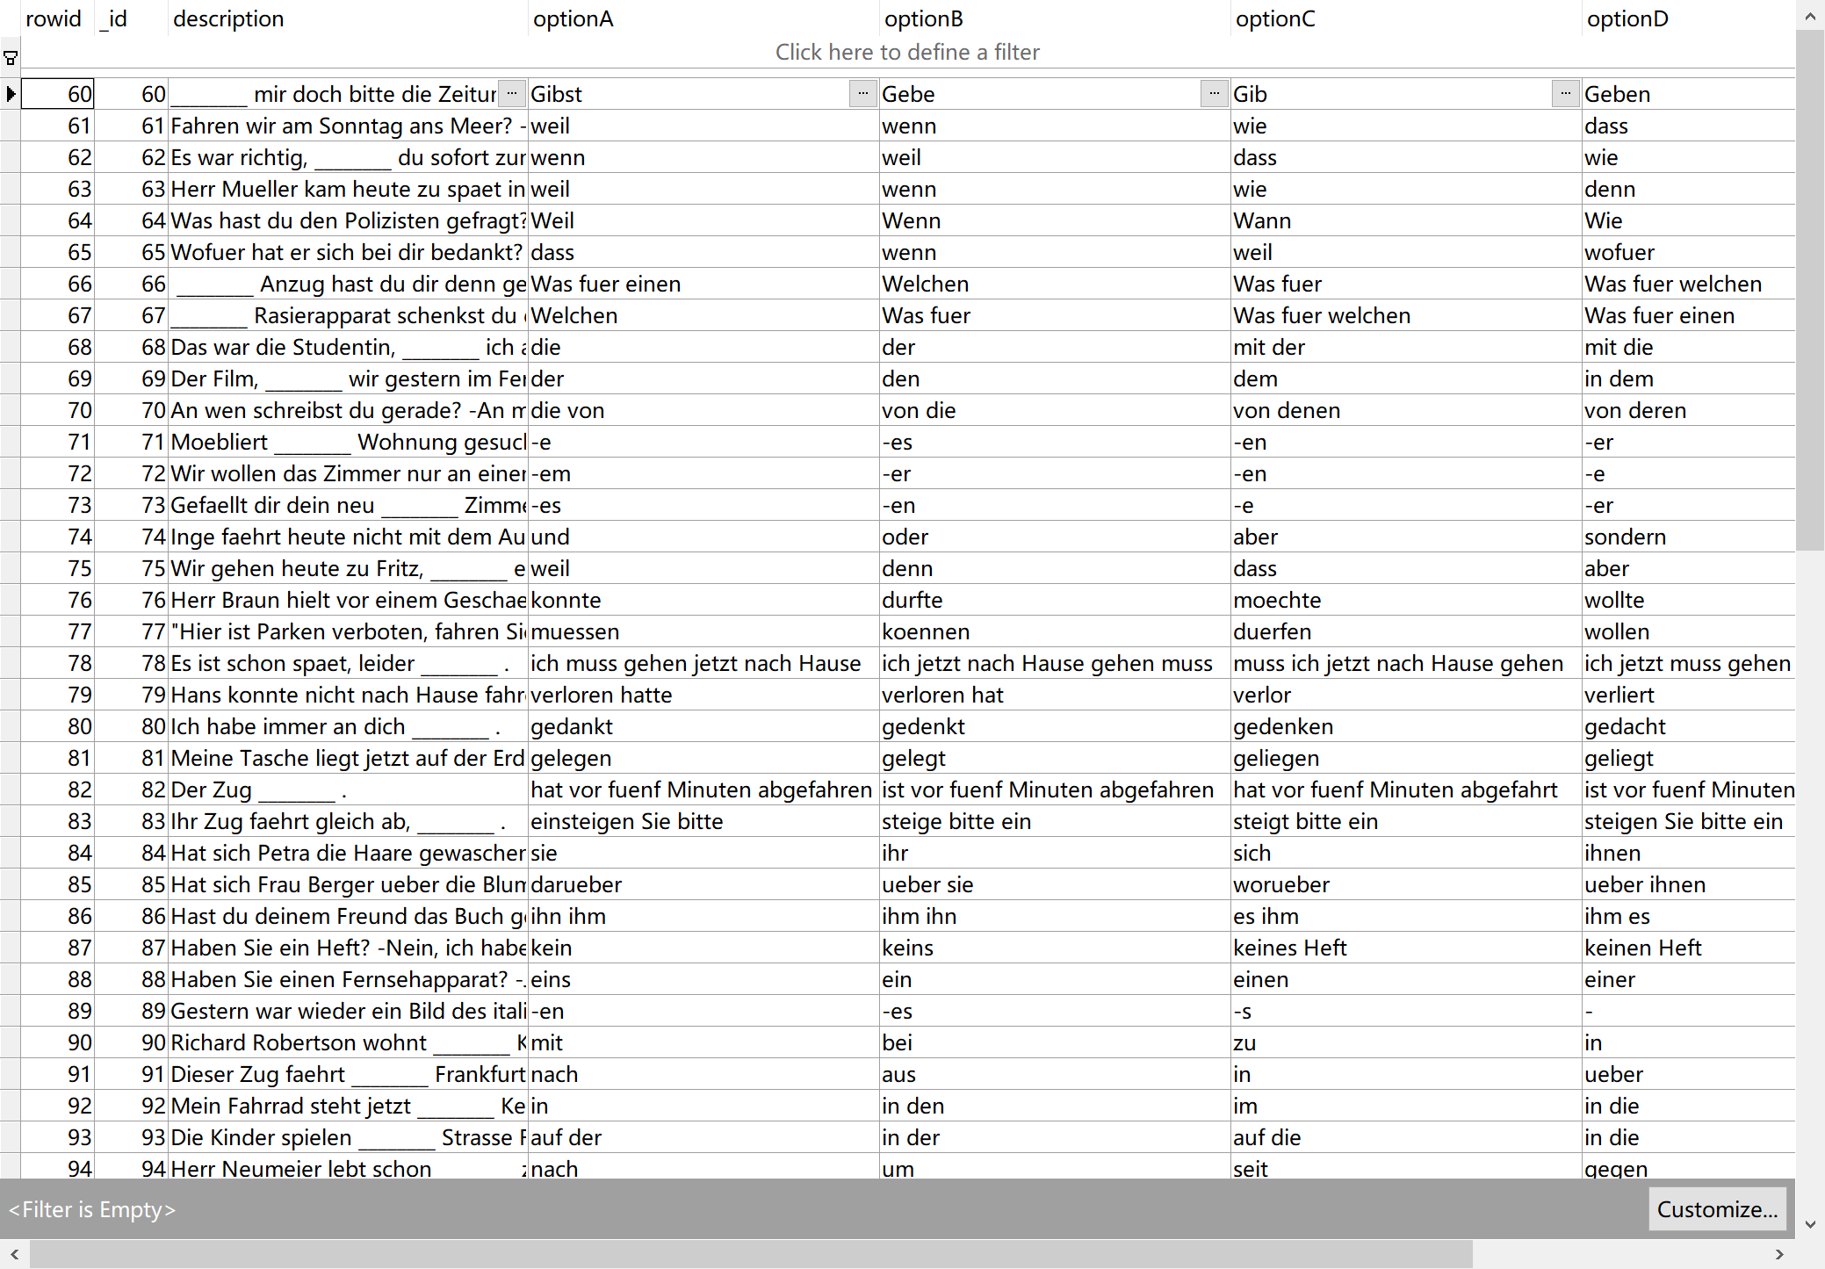
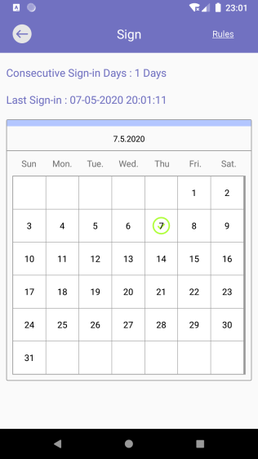
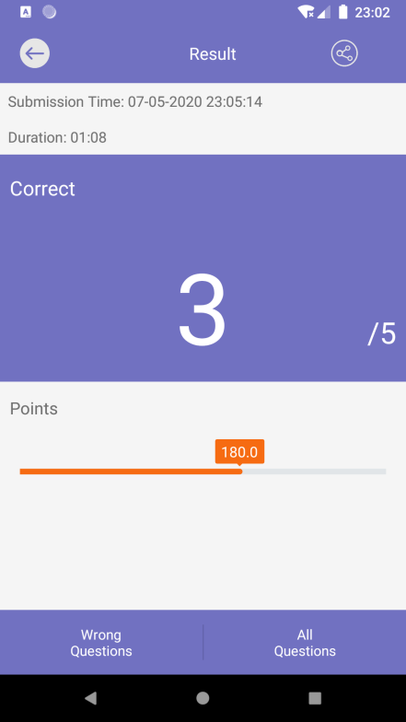
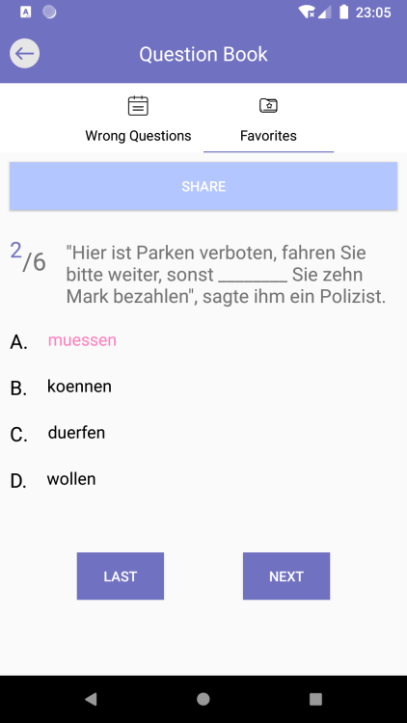
2 Detail of Application
2.1 Function Specification
Local Room Database, SQLite
Customized UI components with Animation
Multiple Activities
Layout, Fragments, View Pager…

Slide 6
2.2 Relationship between Activities
Daily Attendance Activity
Mission Result Activity
Assigned to Junqi.Sun
Mission Activity
Wrong Mode Activity
Assigned to Mengru.Ji
Question Book Activity
Login Activity
Main Activity
Timer Activity
Competition Start Activity
Competition Activity
Signup Activity
Achievement Activity

Slide 7
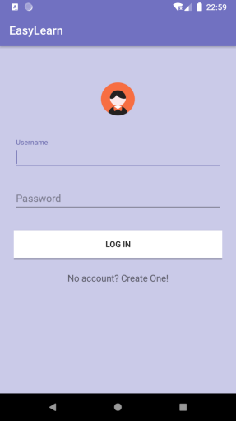
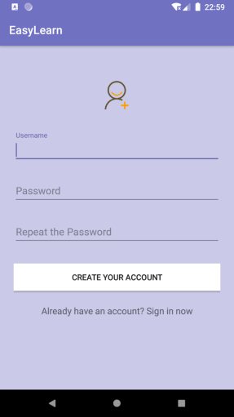
Login and Sign Up Activity
TextInputLayout with EditText
Check your Account and Jump to Main Menu
Check your Input and Create your Account
Jump to Register
Jump to Login

Slide 8
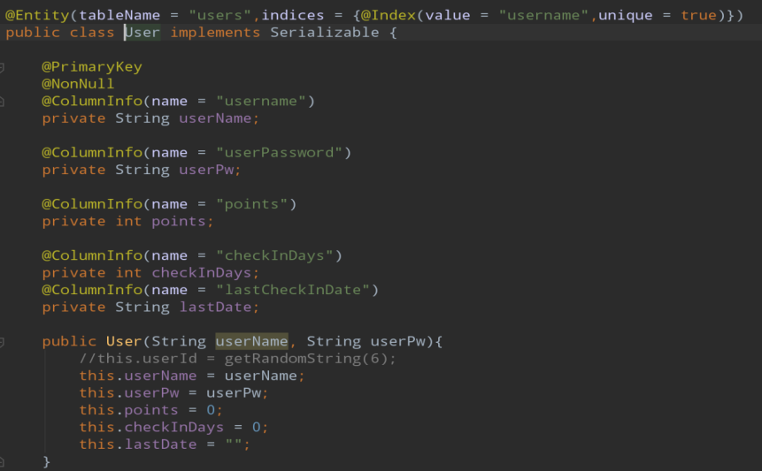
Login and Sign Up Activity
Data(stored in Local Room Database)
User Object:
username(primary key, must be unique)
points
password
continuous daily attendance days
last clock time

Slide 9
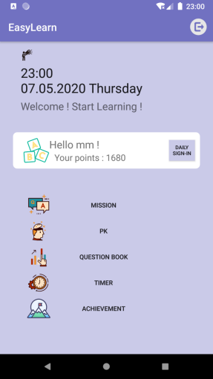
Main Activity
sign out(back to login activity)
current Time
Check your personal account information
Buttons: jump to different activities

Slide 10
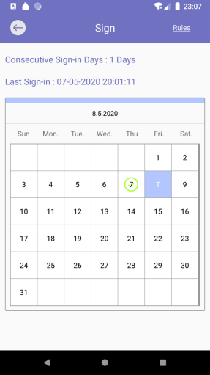
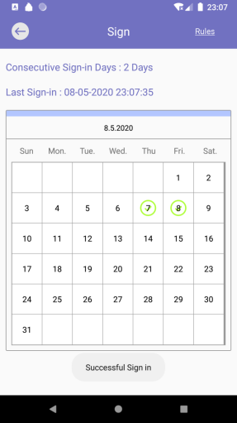
Daily Attendance
Back to Main Menu
Last time clocking info
Update info after clocking
today
Special Calendar
Toast message
before
after

Slide 11
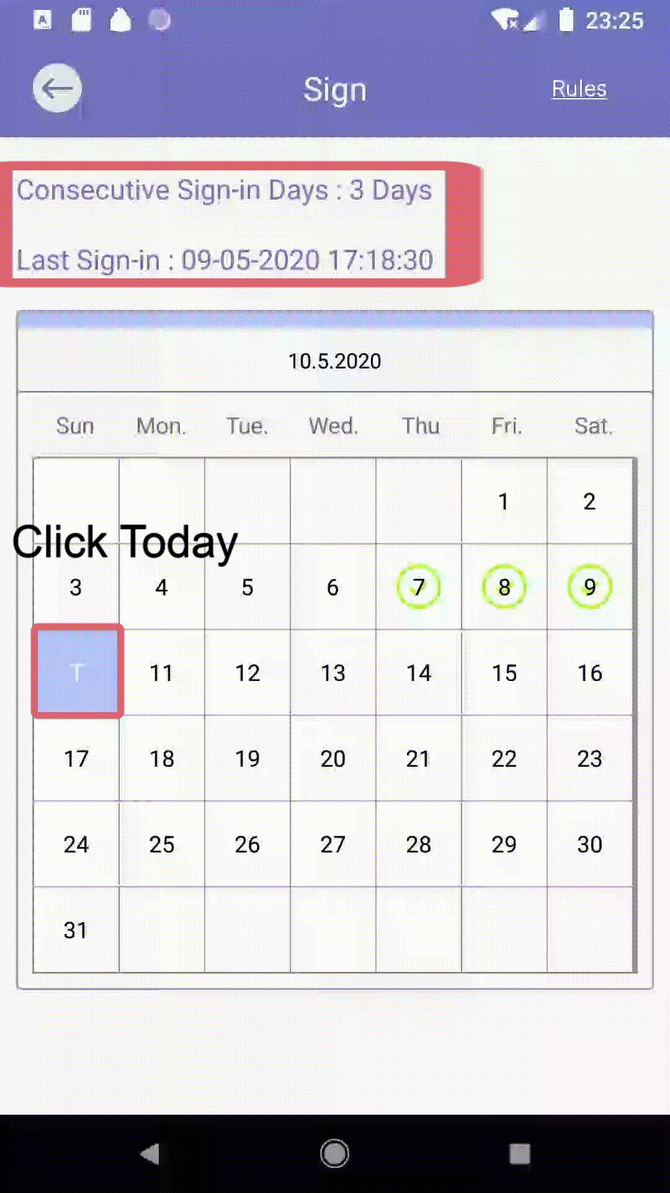
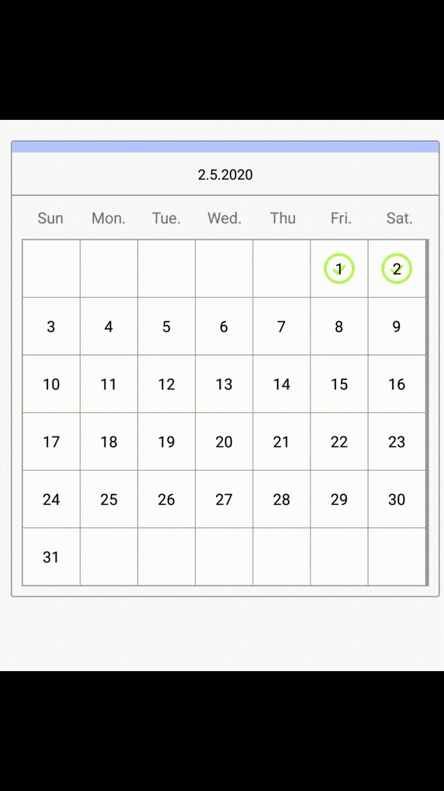
Daily ATTENDANCE
Have not Clocked today
Already Clocked Today

Slide 12
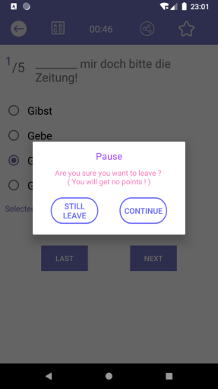
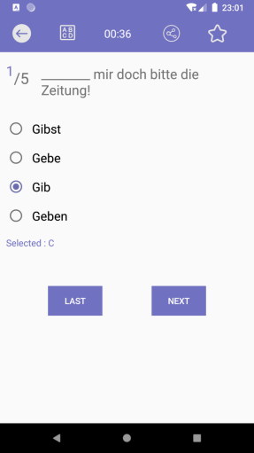
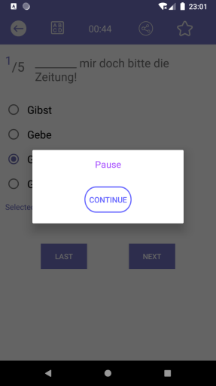
Mission Activity
back
timer
share
Add / remove
favorites
Detail of current question
Previous que
Next que

Slide 13
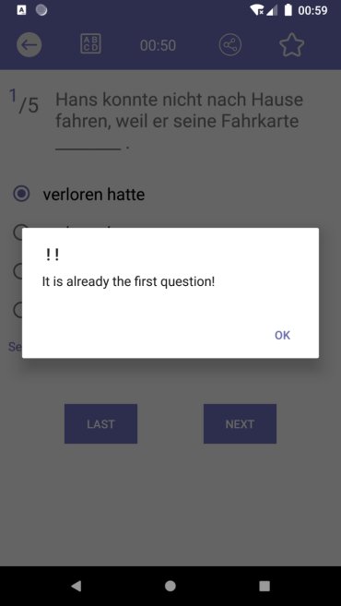
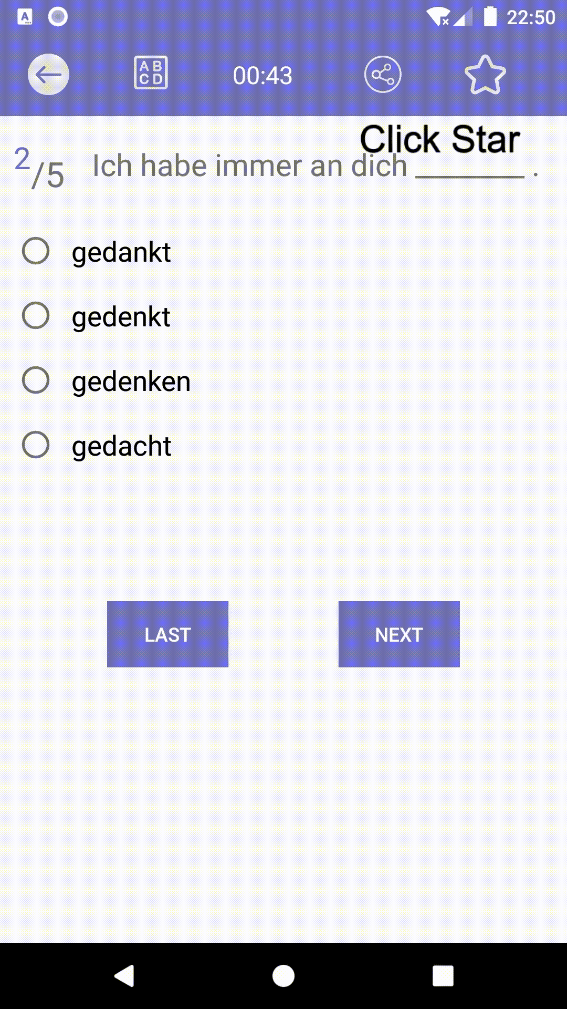
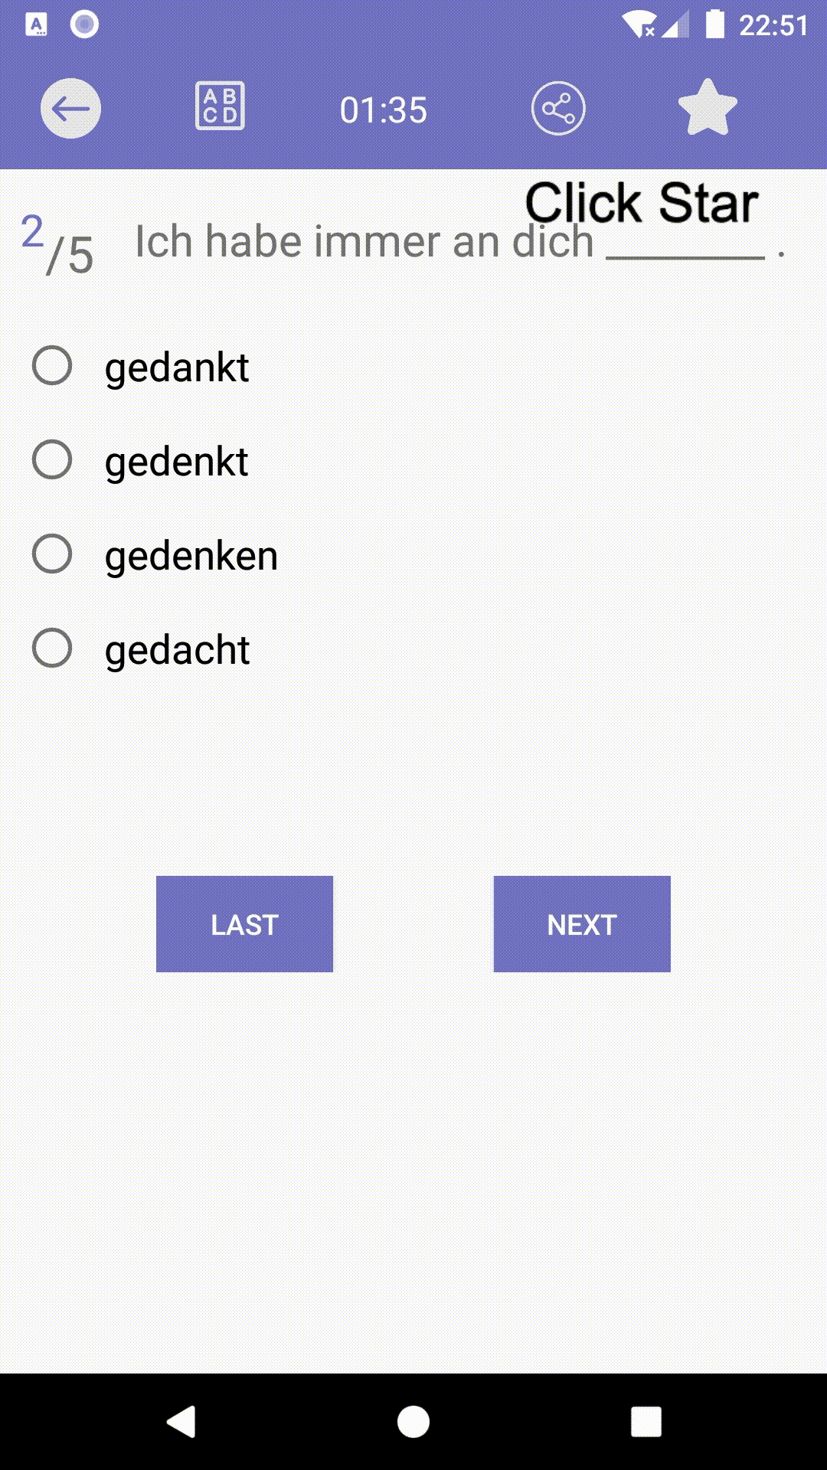
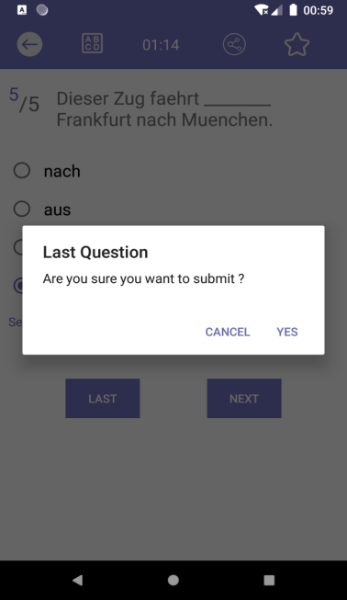
MISSION ACTIVITY
Already the First Question
Already the Last Question
Add Favorites
Remove Favorites

Slide 14
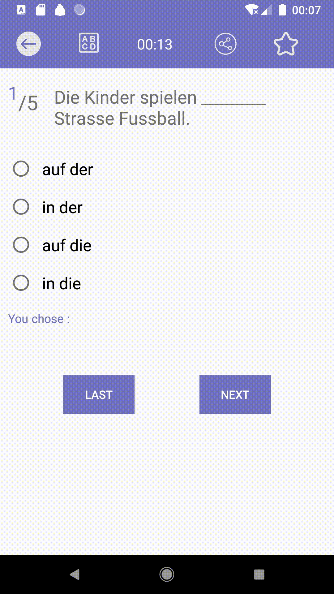
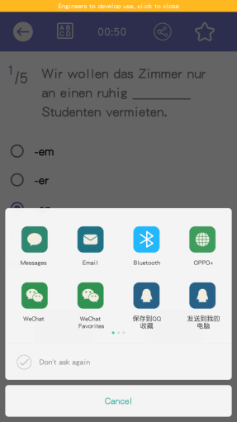
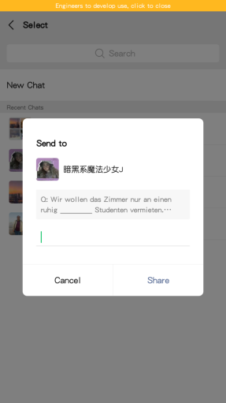
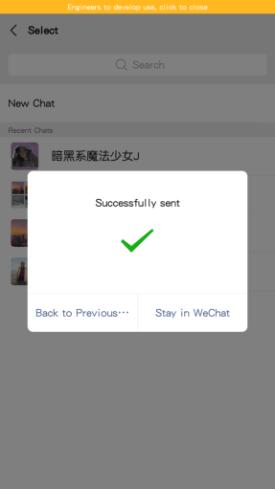
Mission Activity
Share Question

Slide 15
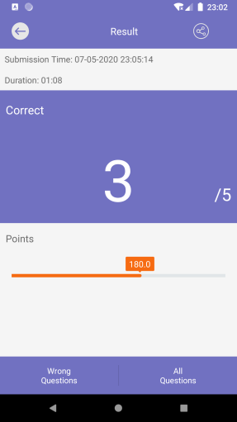
Mission Result Activity
Back to Main Menu
Share your points in form of text
Duration and Submission Time
Number of correct Questions
Points = correct rate * 300
Jump to Wrong Mode Activity to check all wrong questions this time
Jump to Wrong Mode Activity to check all questions this time

Slide 16

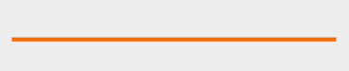
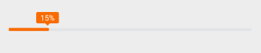
MISSION RESULT ACTIVITY
Tip Box
Actual Progress
Bottom Background
Points = percentage * 300

Slide 17
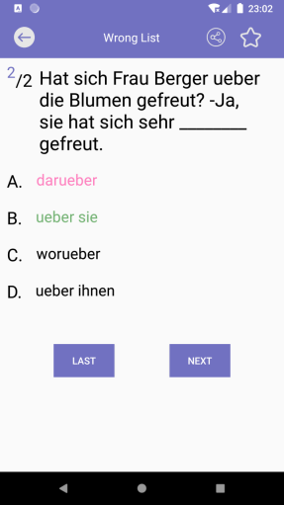
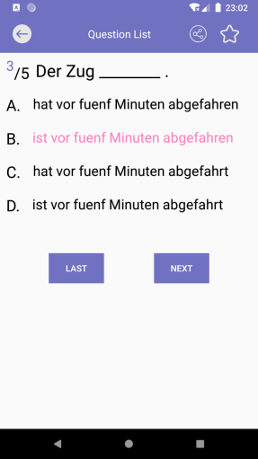
Wrong Mode Activity
All Questions List
Toolbar
(similar with Mission Activity)
Wrong Questions List
Mark your Answer with Green
Mark right Answer with Pink
Detail of Question
Previous que
Next que

Slide 18

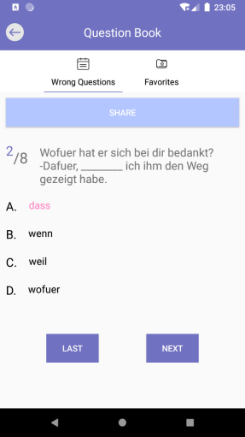
Question Book Activity
Set up with ViewPager(so that can switch Tab through sliding)
TabItem
TabLayout
Fragment

Slide 19
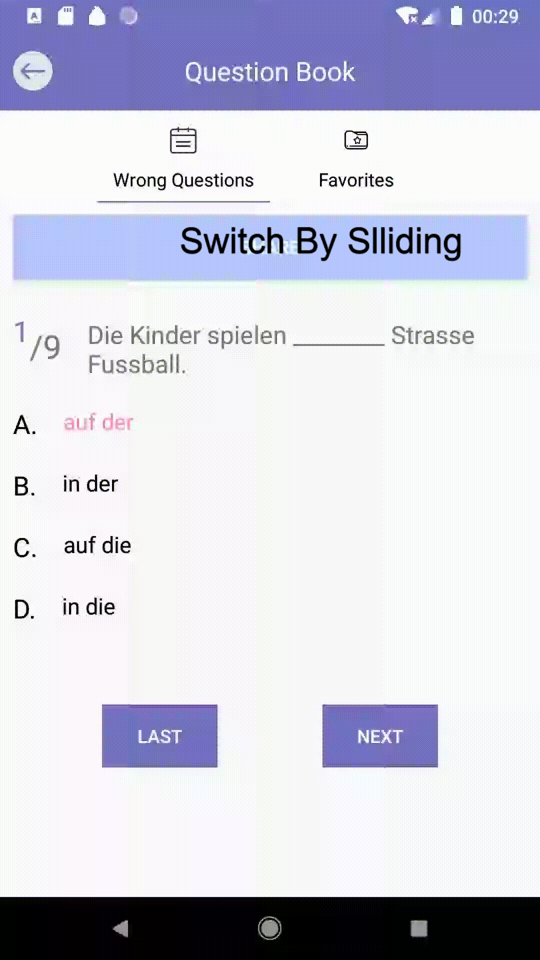
Question Book Activity
More in Future
Direct Deletion of Questions on these two Pages
Direct Addition of Questions into Favorites on Wrong Question Page
Switch By Sliding

Slide 20
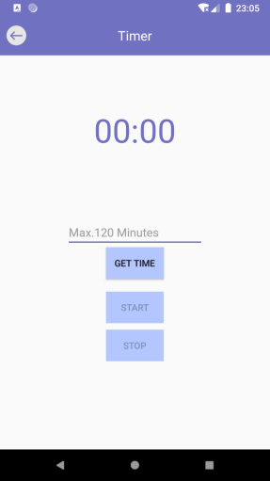
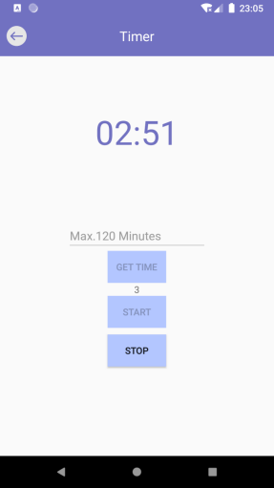
Timer Activity(A Simple Pomodoro)
Countdown
Get Time from EditText
Start Timer
Stop Timer

Slide 21
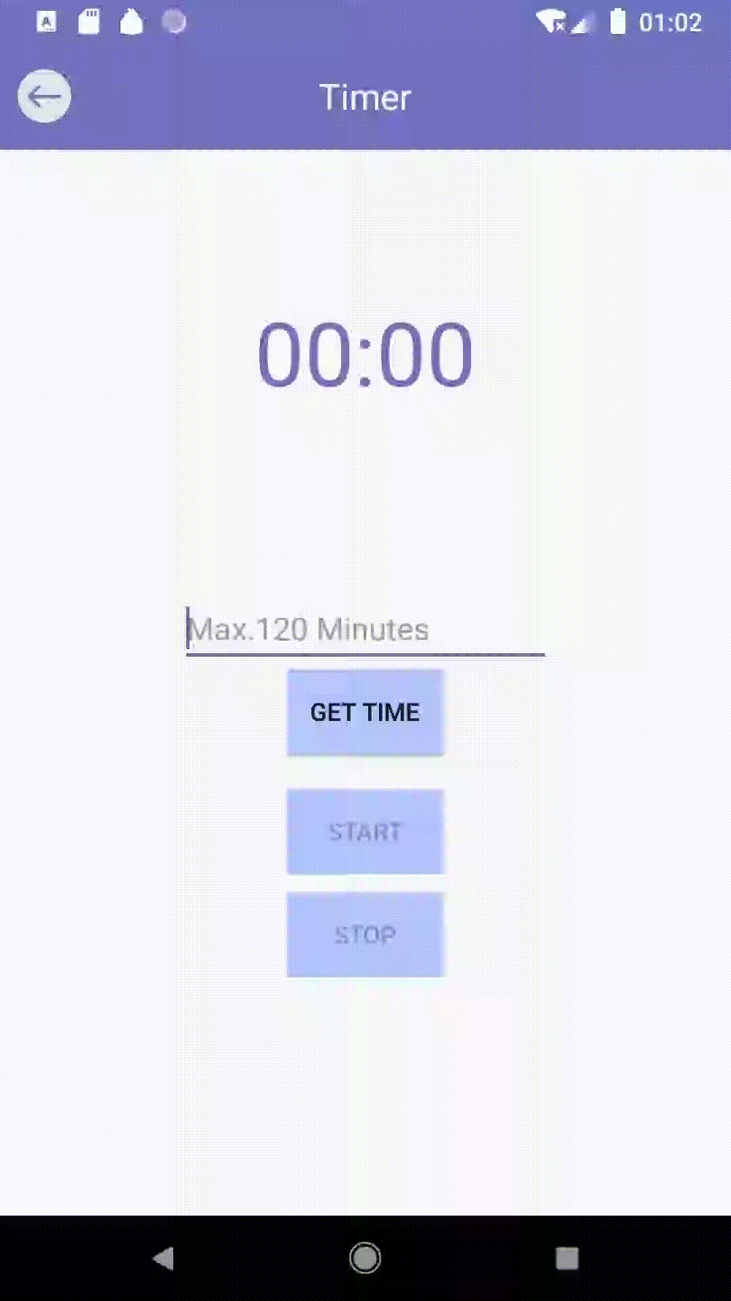
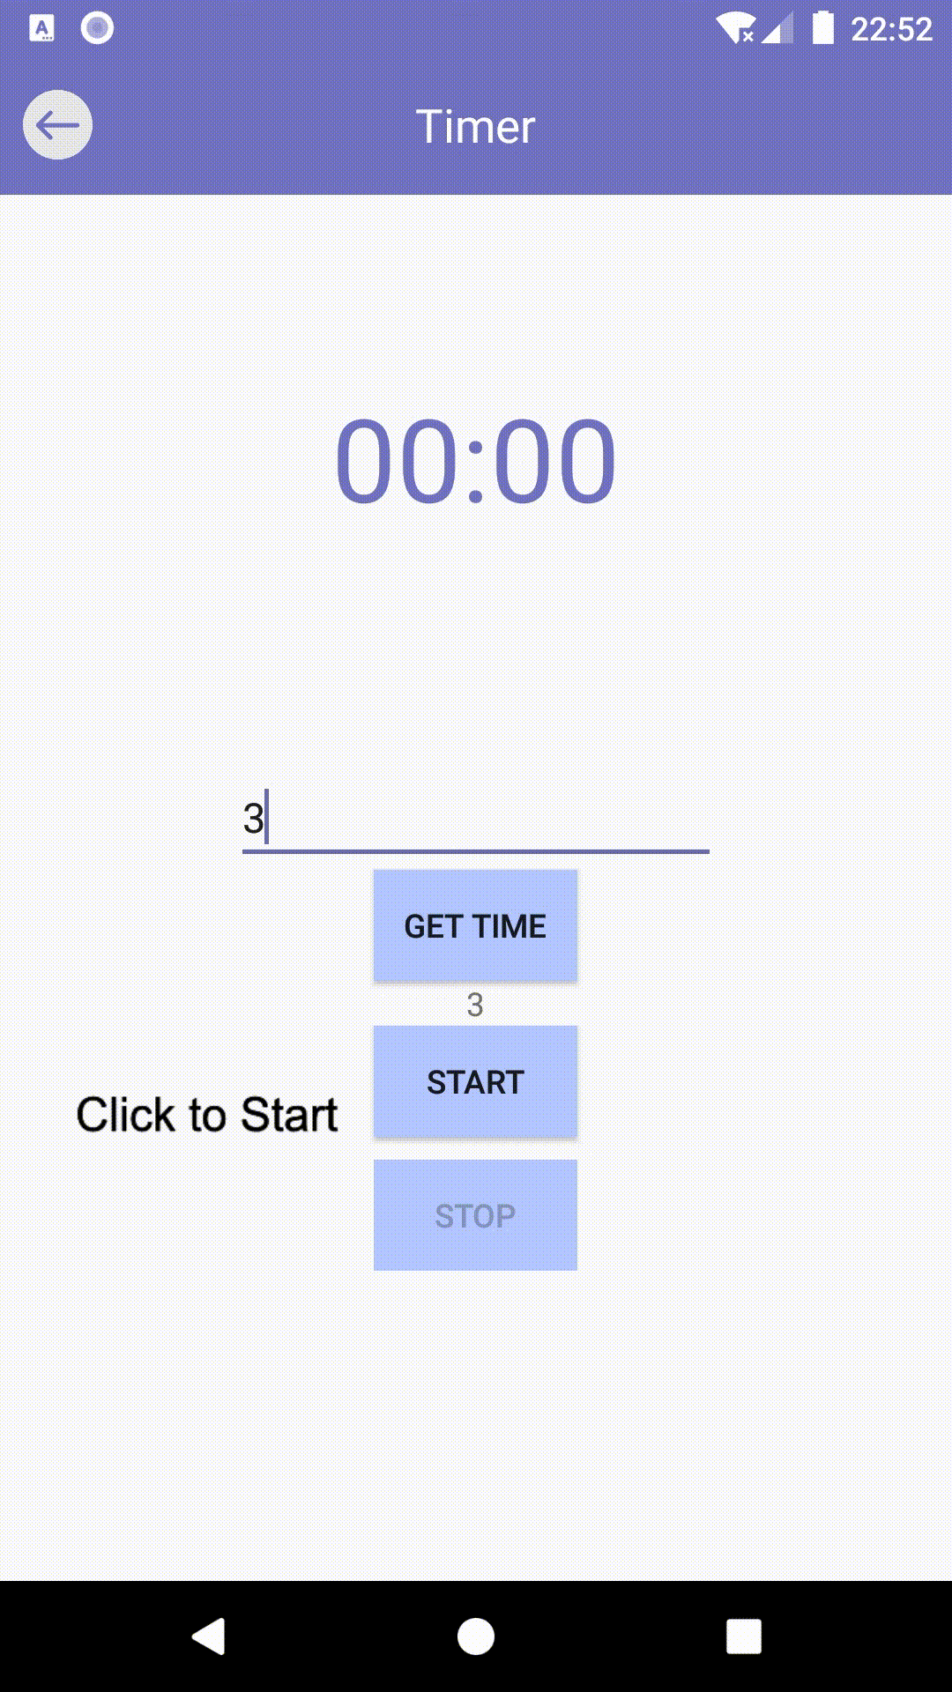
Timer Activity(A Simple Pomodoro)
Get Time from
Edit Text
Click to Start/Stop Countdown

Slide 22
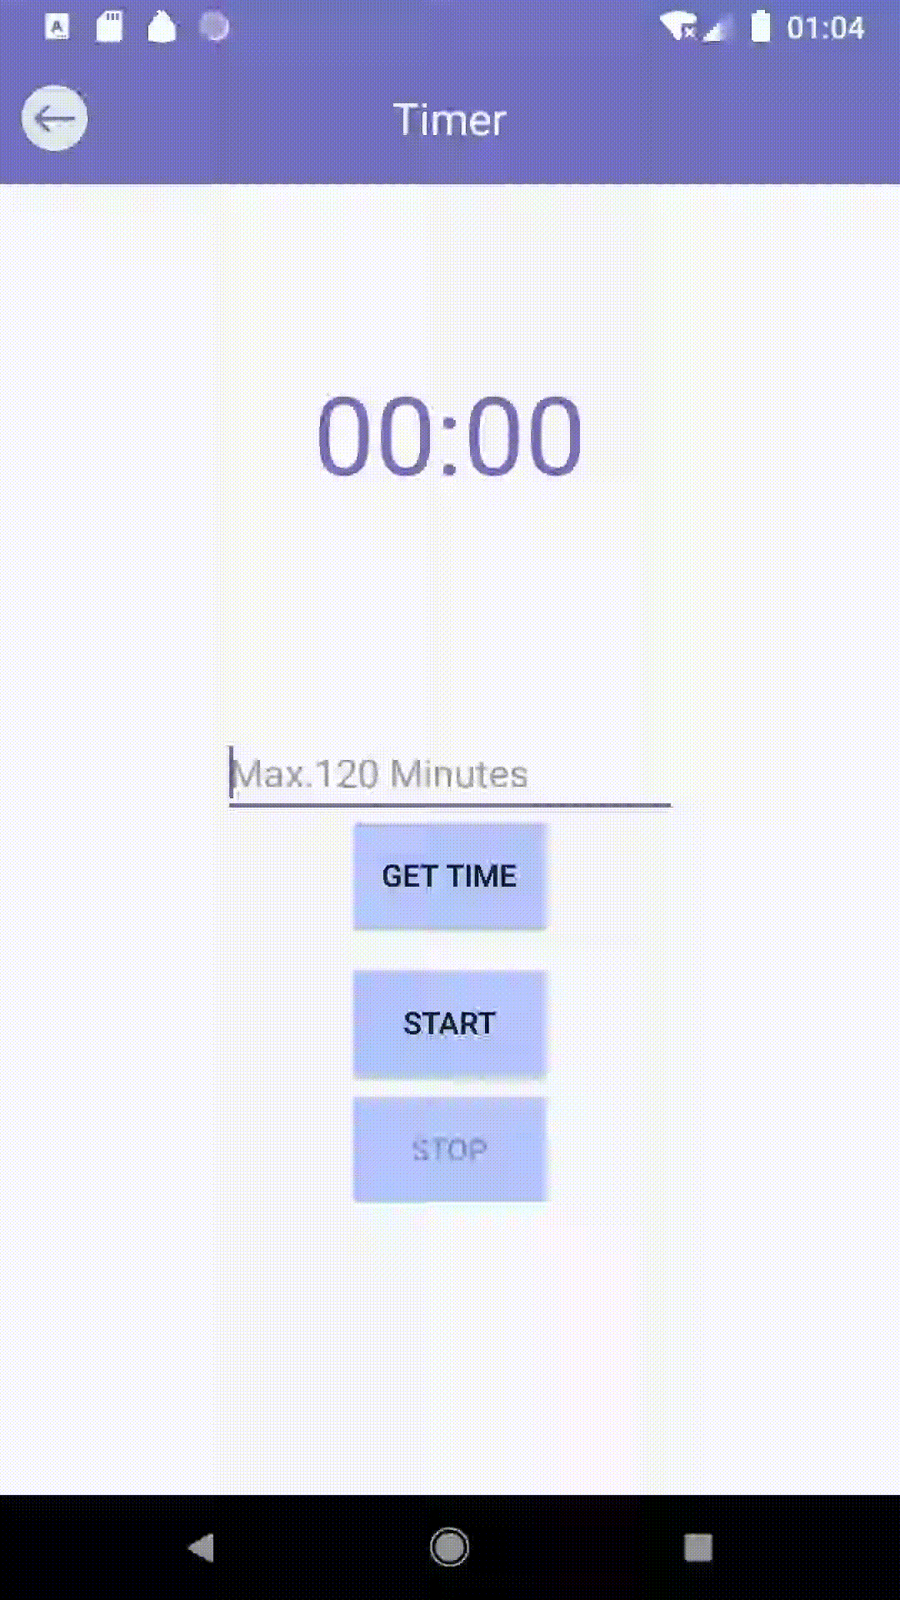

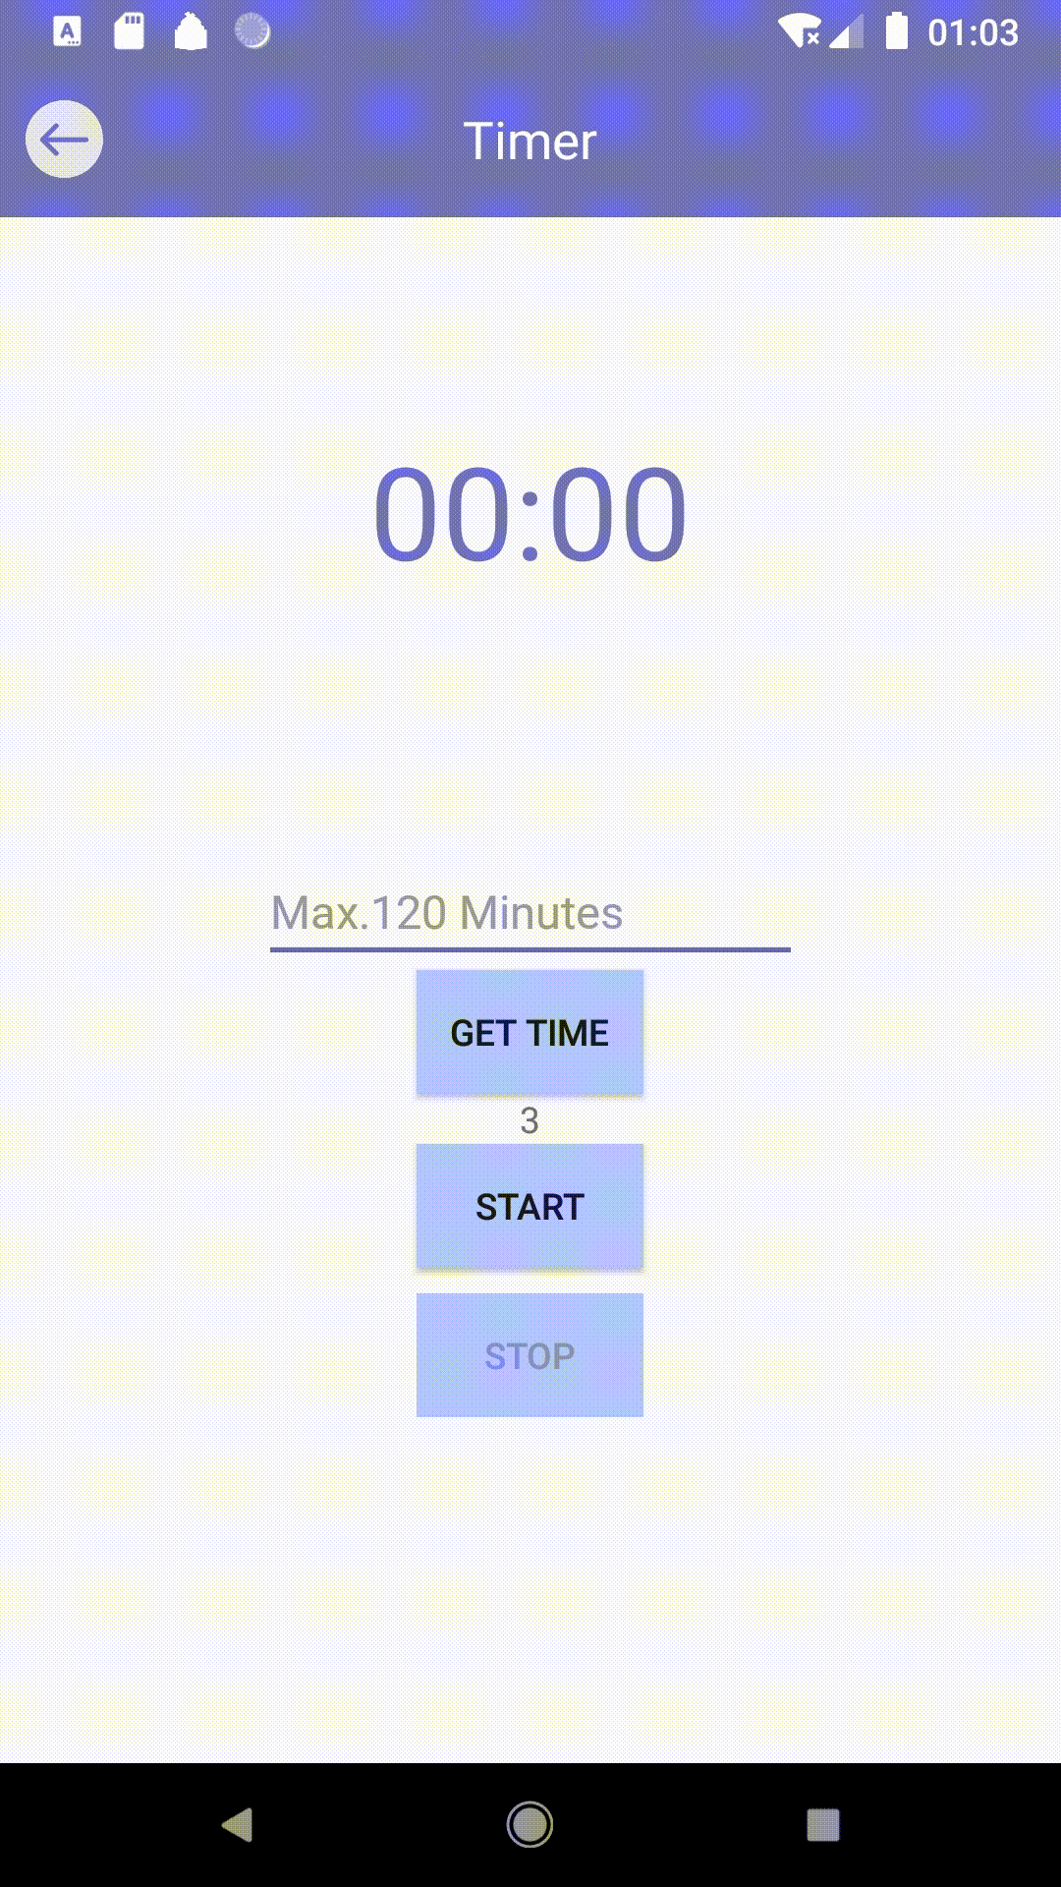
Timer Activity(A Simple Pomodoro)
Empty
Invalid Input( > 120)
Invalid Input( = 0)

Slide 23
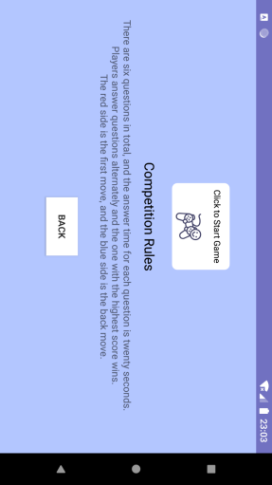
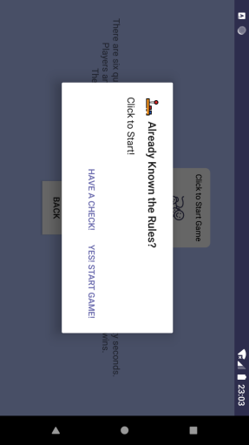
Competition Start Activity
Back to Main Menu
Back
Jump to Competition Activity

Slide 24
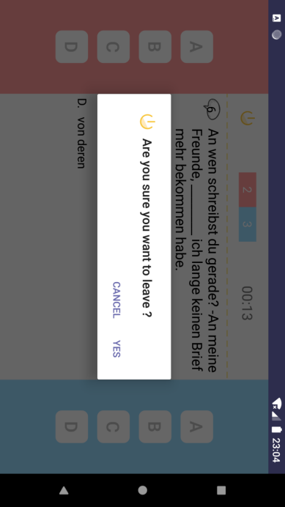
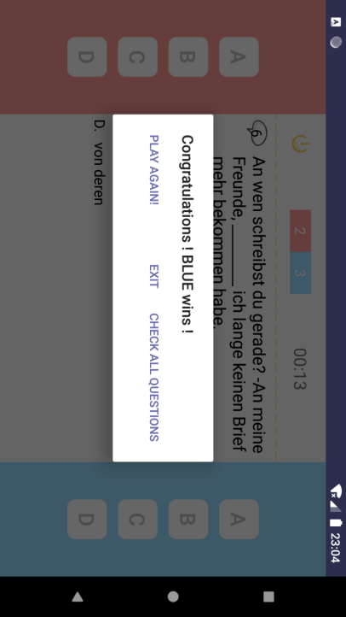
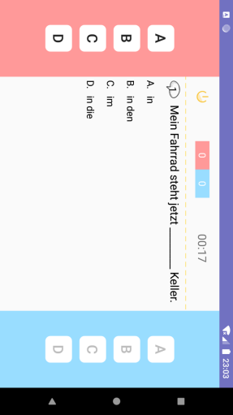
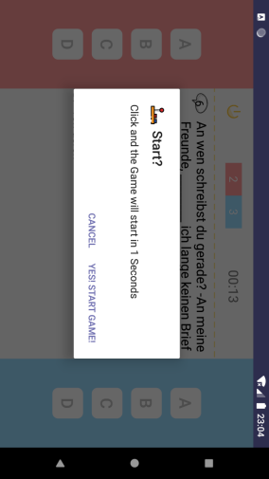
Competition Activity
Score
Countdown(20 seconds for each Answer)
When Game finished
Back to Main
Back to Main Menu
Jump to
WrongMode Activity
Red answer area
Blue answer area

Slide 25
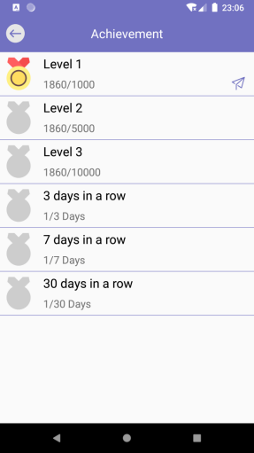
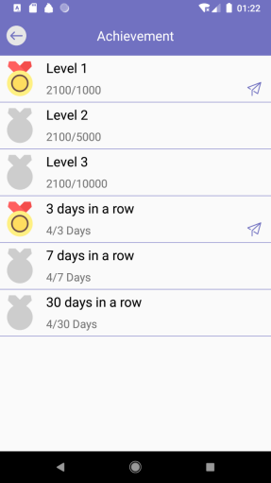
Achievements Activity

Slide 26
Summary
Terrible Organization at beginning of our Project, so cost a lot of time to rewrite and reconstruct
Still have a Problem: How to make a notification on a low API device(for example API 23)?
Have tried lots of UI Components that never used before, and customized them by ourselves
Needs more good designed Achievements and Bonus which related to our interest, so that we can have more Passion in learning German

Slide 27

Thanks!
Mengru.JI
Junqi.Sun

